Slide 1
Project Module Week 2
Slides by: Mansi Udani

Slide 2
Agenda:
Contents
Background
Research Question
Objectives
Motivation
Technical Approach
Special Resources required
Project Plan
Technical Details
Evaluation
References

Slide 3
Objectives
The project involves thinking in more detail about your research objectives. Research objectives should be closely related to the statement of the problem and summarize what you hope will be achieved by the study.
For example, if the problem identified is low utilization of antenatal care services, the general objective of the study could be to identify the reasons for this low uptake, in order to find ways of improving it.

Slide 4
Objectives
Writing your project objectives clearly helps to:
Define the focus of your study
Clearly identify variables to be measured
Indicate the various steps to be involved
Establish the limits of the study
Avoid collection of any data that is not strictly necessary.

Slide 5
Objectives
Objectives can be general or specific. The general objective of your study states what you expect to achieve in general terms. Specific objectives break down the general objective into smaller, logically connected parts that systematically address the various aspects of the problem. Your specific objectives should specify exactly what you will do in each phase of your study, how, where, when and for what purpose.
Your objectives should be stated using action verbs that are specific enough to be measured, for example: to compare, to calculate, to assess, to determine, to verify, to calculate, to describe, to explain, etc. Avoid the use of vague non-active verbs such as: to appreciate, to understand, to believe, to study, etc., because it is difficult to evaluate whether they have been achieved.

Slide 6
Example Objectives
A research study designed to assess the accessibility and acceptability of the Voluntary Counselling and Testing (VCT) Services for HIV infection in kebele X had the following general and specific objectives:
General objective: To identify factors that affects the acceptability of VCT services and to assess community attitudes towards comprehensive care and support for people living with HIV/AIDS.
Specific objectives:
To assess the knowledge, attitude and practice of the community towards HIV/AIDS and VCT services.
To identify barriers and concerns related to VCT and its uptake.
To assess the awareness and perception of the study community regarding comprehensive care and support for people living with HIV/AIDS.

Slide 7
Example Objectives
Specific objectives:
Develop a feed management gateway service using Java, Spring, MongoDB and RabbitMQ for uploading over 3 million unique products across 20 categories and 6 clients to Google Merchant Center.
Streamline user invoicing process by 15 - 20% through constructing 2 major pages (from UI to backend) that merge the rates and bills procedures with Java, Spring, and DB2.
Implement Spring Security for user authentication. Remove custom login routines which failed internal security audits. Reduce common vulnerability attacks and standardize username and password storage across the application.
Drive the adoption of full CI/CD development practices thereby making production deployments robust, efficient and reduced time to production by over 90% with zero downtime requirements.
Ref: https://www.viamaven.com/blog/goal-setting-examples-software-developers

Slide 8
Action Words for Objectives and Technical Approach
Understanding (Understanding and organizing information) | Applying (Solving problems using information) | Analysing (reaching conclusion from evidence) | Synthesising (Breaking down into components) | Evaluating (Judging merit)
Review Identify Explore Discover Discuss Summarize Describe | Interpret Apply Demonstrate Establish Determine Estimate Calculate Relate | Analyse Compare Inspect Examine Verify Select Test Arrange | Propose Design Formulate Collect Construct Prepare Undertake Assemble | Appraise Evaluate Compare Assess Recommend Conclude Select

Slide 9
Background
The background of the study is a part of a research provided in the introduction section of the paper. It is a compilation of adequate information that is based on the analysis of the problem or proposed argument, the steps and methods needed to arrive at the design, the implementation of the results achieved, and feasible solutions.
It is different from the introduction. The introduction only contains the preliminary information about your research question or project topic. It is simply an overview of the research question or project topic. But the background of your study is more in-depth - it explains why your research topic or project is worth the time of your readers.
Read more: https://www.legit.ng/1174941-background-study-research-write-2021.html
Read more: https://www.legit.ng/1174941-background-study-research-write-2021.html

Slide 10
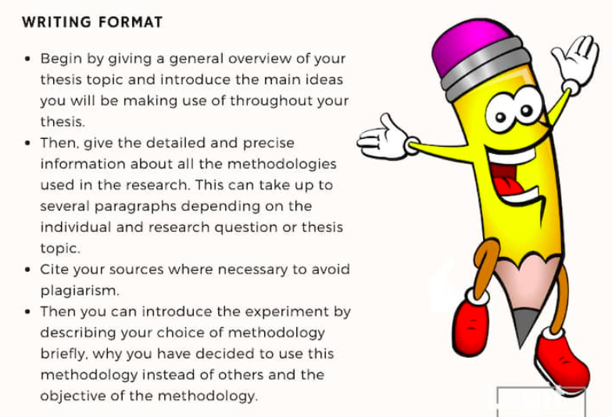
Background

Slide 11
Motivation Example (Gibberish)
People have wondered about how to better understand frobs ever since Richard Feynman first used them to pick the locks in Los Alamos. Although X, Y, and Z attempts have been made, none of them got very far because they were all green-colored. In this project, the objective is to examine an alternate path, reducing the problem of frobs to the simpler system of greebit-space by means of an innovative application of wibbling. These results bring us one step closer to solving the problem of frobs, and how they can be better used to quickly and cheaply pick locks.
At least 2-3 paragraphs

Slide 12
Technical Approach
Start by writing a little about you project
How will technical approach help you
Follow a methodology
Steps:
Literature Review
Planning, Requirements, Design, Build, Document, Test, Deploy, Maintain.

Slide 13
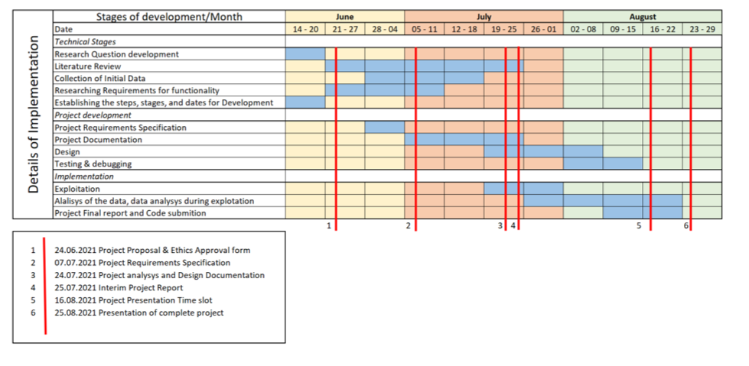
Project Plan (Screenshot From Sample 3)

Slide 14
Technical Details
Implementing language and why
Which Libraries are you using ?
What does that library do ?
How does it help your data?
Don’t forget to write a little about the library

Slide 15
Evaluation
Describe how you will evaluate the system with real technical data using system tests, integration tests etc. In addition, where possible describe how you will evaluate the system with an end user.

Slide 16
Last steps:
End the Proposal with your signature.
Check for spelling Errors
References in the correct format
Don’t write very long sentences
Read papers for a good title (Max 15 words)
Write the content in your own words, if not paraphrase well and cite the source.

Slide 17

Questions

